Slide 2
Modern Web Development in Azure
Hamida REBAI
Architect, Microsoft MVP Developer Technologies

Slide 3






Hamida REBAI TRABELSI
MVP in Developer Technologies
Software architect
Dotnetfoundation Member
@rebaihamida
didourebai@gmail.com
https://www.linkedin.com/in/hamida-rebai-trabelsi-09b8525/

Slide 4
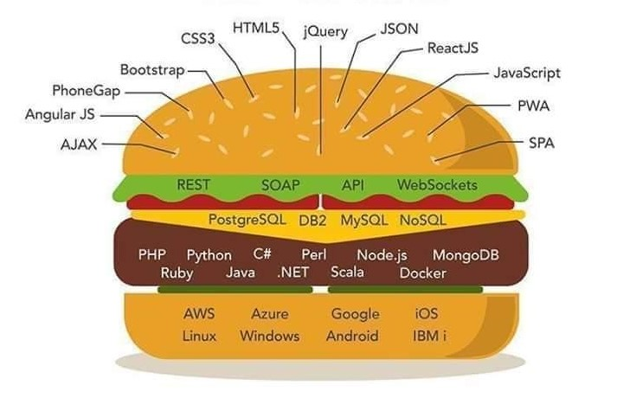
Agenda
Client side web technologies
Server side web technologies
SGBDR and NoSQL
Languages
OS and Cloud Provider
Notes:
To build any project, you need to have an idea about every layer presented here.
We have to know about client-side web technologies that we can use it.
Server-side web technologies, language to be used and the framework, then the architecture that can be a monolith or microservices and Cloud-Native Apps for and in the end, we will deploy it in the cloud-in Microsoft Azure.
Developers today required to know what cloud offer to deploy their apps, choose the best solution to a specific project, small project is not like multitenancy or complex system.
So, what is required to build a modern application for a user?

Slide 5
Introduction
Modern web applications have higher user expectations and greater demands than ever before.
Available from anywhere in the world.
Usable from virtual any device or screen size.
Secure, flexible and scalable.
Cross platform.
Modular and loosely coupled.
Simple development and deployment.
Cloud-hosted
Notes:
Before searching for an answer, we need to know what user is expecting from an app.
Today's web apps are expected to be available anytime from anywhere in the world, and usable from virtually any device or screen size. Web applications must be secure, flexible, and scalable to meet spikes in demand. Increasingly, complex scenarios should be handled by rich user experiences built on the client using JavaScript, and communicating efficiently through web APIs.

Slide 6
Client side web technologies
Notes:
We will start from the top of our sandwich to mention client side web techologies that we can use it in any kind of project.

Slide 7
Agenda
Client side web technologies
Server side web technologies
SGBDR and NoSQL
Languages
OS and Cloud Provider

Slide 8
JavaScript libraries and frameworks
Notes:
Popular JavaScript libraries and frameworks are incredibly useful tools for any front-end web designer to be familiar with. They can add powerful functionality to your site or help you create current web design trends, resulting in exceptional experiences for your users.

Slide 9
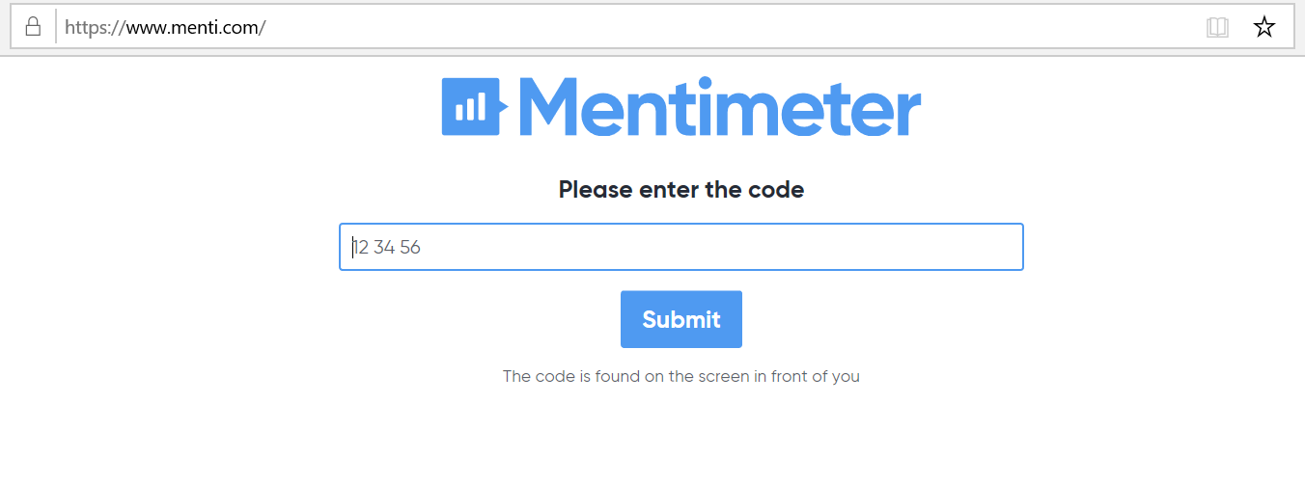

Slide 10








JavaScript Framework
Notes:
Aurelia
Angular
Ember
Ionic
Mocha
Next.js
Vue.js
Webix

Slide 11




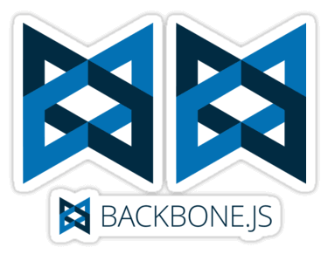



JavaScript Libraries
Notes:
JavaScript is one of the most popular programming languages on the web. A JavaScript library is a library of pre-written JavaScript which allows easier access throughout the development of your website or application. For example, you can include a copy of Google’s hosted jQuery library by using the following snippet.
jQuery: A fast, small, and feature-rich JavaScript library.
BackBoneJS: Give your JS app some backbone with models, views, collections, & events.
D3.js: A JavaScript library for manipulating documents based on data.
React: Facebook’s JavaScript library developed for building user interfaces.
jQuery UI: A curated set of user interface interactions, effects, widgets, and themes.
jQuery Mobile: HTML5-based user interface system designed to make responsive web sites.
Underscore.js: Functional programming helpers without extending any built-in objects.
Moment.js: Parse, validate, manipulate, and display dates in JavaScript.
Lodash: A modern utility library delivering modularity, performance, & extras.

Slide 12
Front-end Frameworks

Slide 14



Front-end Frameworks
Notes:
Front-end frameworks usually consist of a package that is made up of other files and folders, such as HTML, CSS, JavasScript, etc. There are also many stand-alone frameworks out there. We are a big fan of Boostrap and the main KeyCDN website is built on it. A solid framework can be an essential tool for front-end developers.
Bootstrap: HTML, CSS, and JS framework for developing responsive, mobile first projects on the web.
Semantic UI: Development framework that helps create beautiful, responsive layouts using human-friendly HTML.
uikit: A lightweight and modular front-end framework for developing fast and powerful web interfaces.

Slide 15
Web Application Frameworks

Slide 17







Web Application Frameworks
Notes:
And we finish by web application frameworks, so I ask you again to answer to this question.
And in this case, it depends from Traditional Web Apps and Single Page Apps (SPAs), in the list we have angular, the new version use typescript not JavaScript, and we have more that you can use, what is presented is not for advertising, it’s according my experience, maybe you have more, for this reason I decided to ask you before to share after what I recommend.
Now, I will focus on .NET Core and Blazor.
----
Knockout and angular
Frontend Development
React and Vue.js
Django: High-level Python Web framework that encourages rapid development and clean, pragmatic design.
pragmatic design.
ASP.net: Free, fully supported Web application framework that helps you create standards-based Web solutions.
Laravel: A free, open source PHP web application framework to build web applications on MVC pattern.

Slide 18
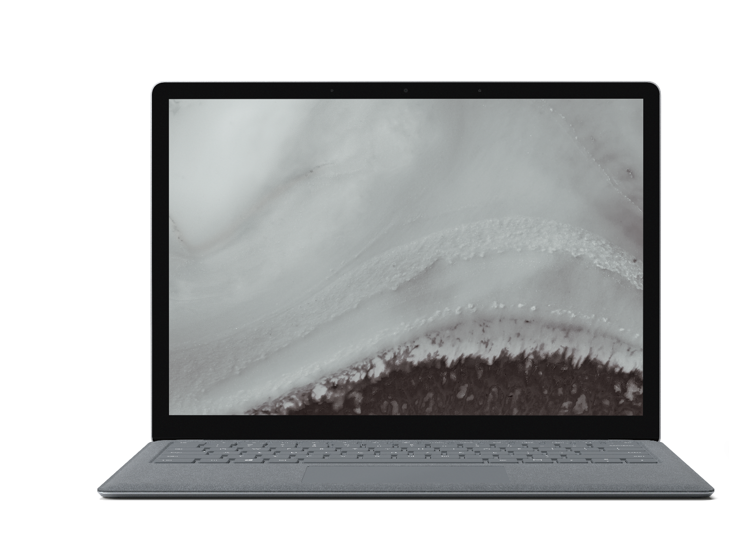
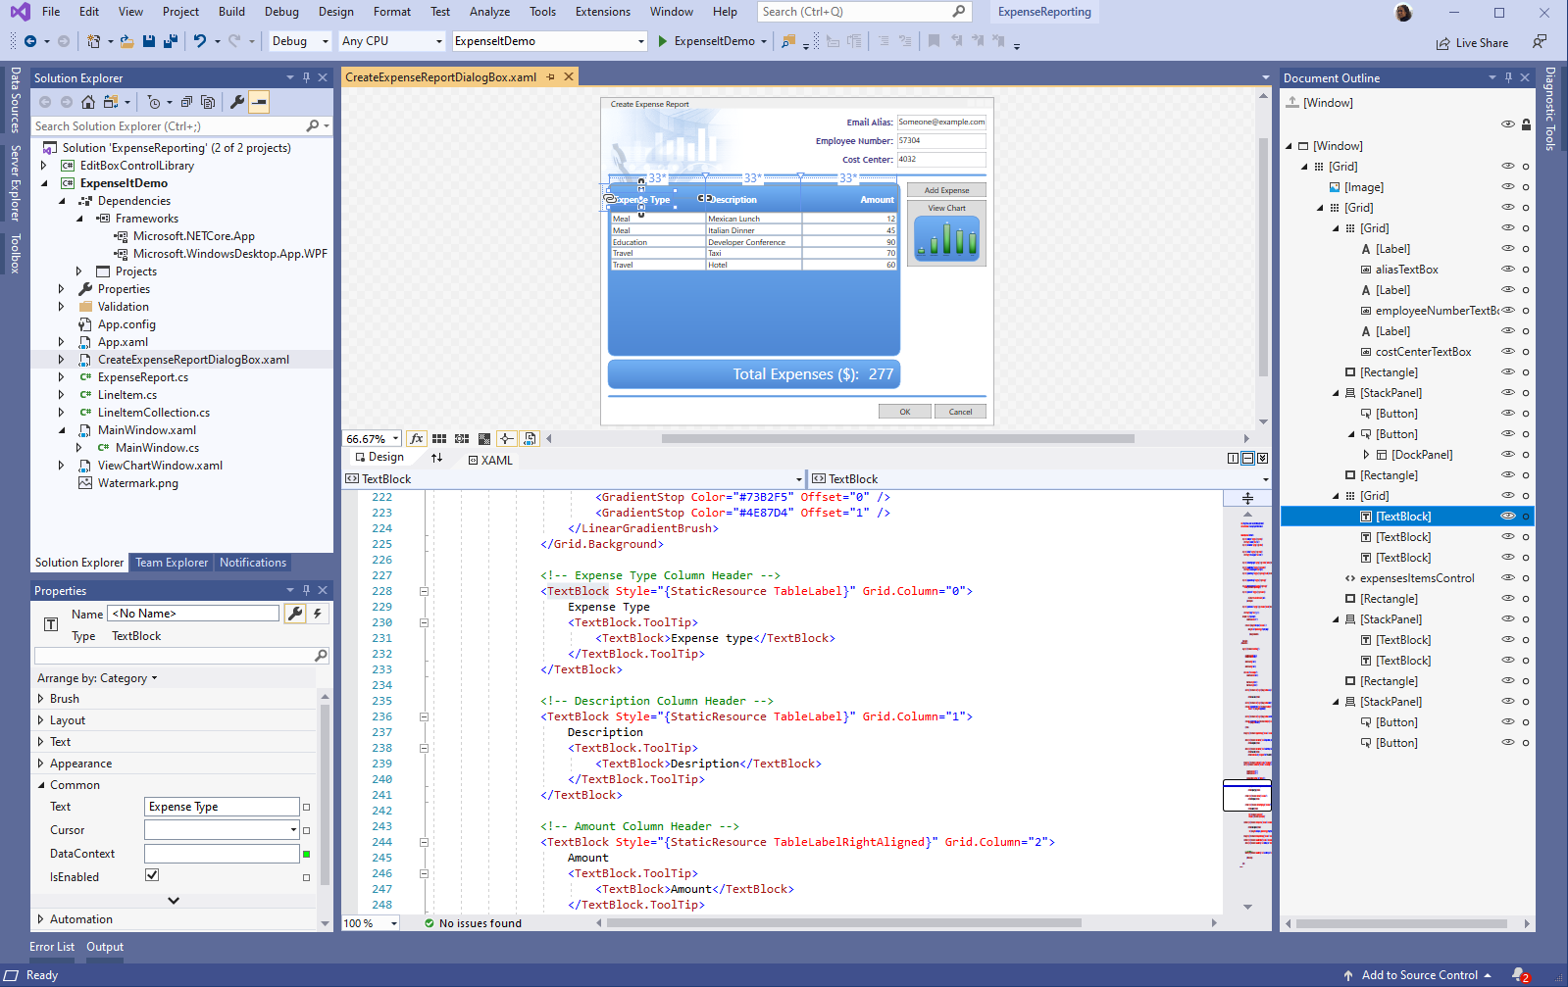
.NET Core 3.1
RELEASED
Long-Term Support (LTS) Preview 2
WPF and Windows Forms support
Side-by-side support & self-contained EXEs
Full-stack web development with C# and Razor
New C# 8.0 language features
dot.net
Notes:
.NET Core is a cross-platform version of .NET for building websites, services, and console apps.
And now we are in .net core 3.1 in release mode, and from 3.0 we have New C# 8.0 language features where we have many changes like implementing an operation inside an interface, the new Json API System.Text.Json dedicated to manage faster a json with support for a reader/writer, a document object model (DOM), and a serializer. And we have the support of desktop app like WPF, Windows forms.
And in this framework, we will talk about asp.net and blazer.

Slide 19
ASP.NET Core
Optimized for modern web applications and cloud-based hosting scenarios.
Modular design.
Include features to improve application security and performance.
Easily tested with automated tests
Notes:
ASP.NET Core is optimized for modern web applications and cloud-based hosting scenarios. Its modular design enables applications to depend on only those features they actually use, improving application security and performance while reducing hosting resource requirements.
ASP.NET Core include MVC, SPA , Web API and many templates.

Slide 20
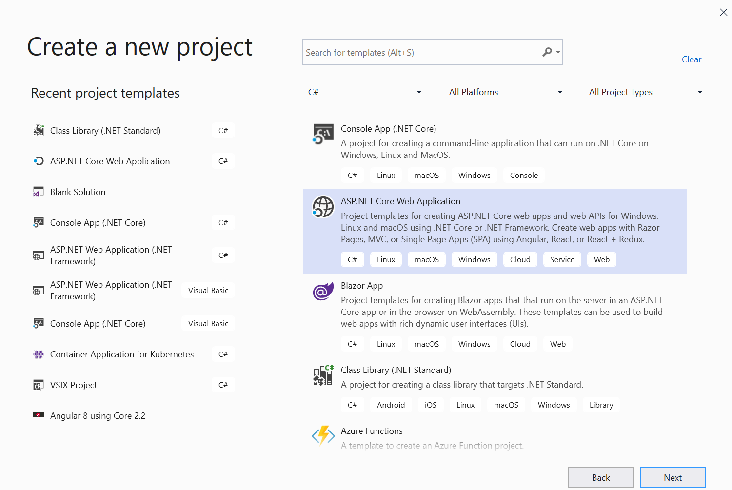
Notes:
And to create an ASP.NET app, you can use the last version of Visual Studio 2019 for example, I will present after more tools, and here, we choose, ASP.NET Web Application and you can find the list of the templates that you can use it.

Slide 21
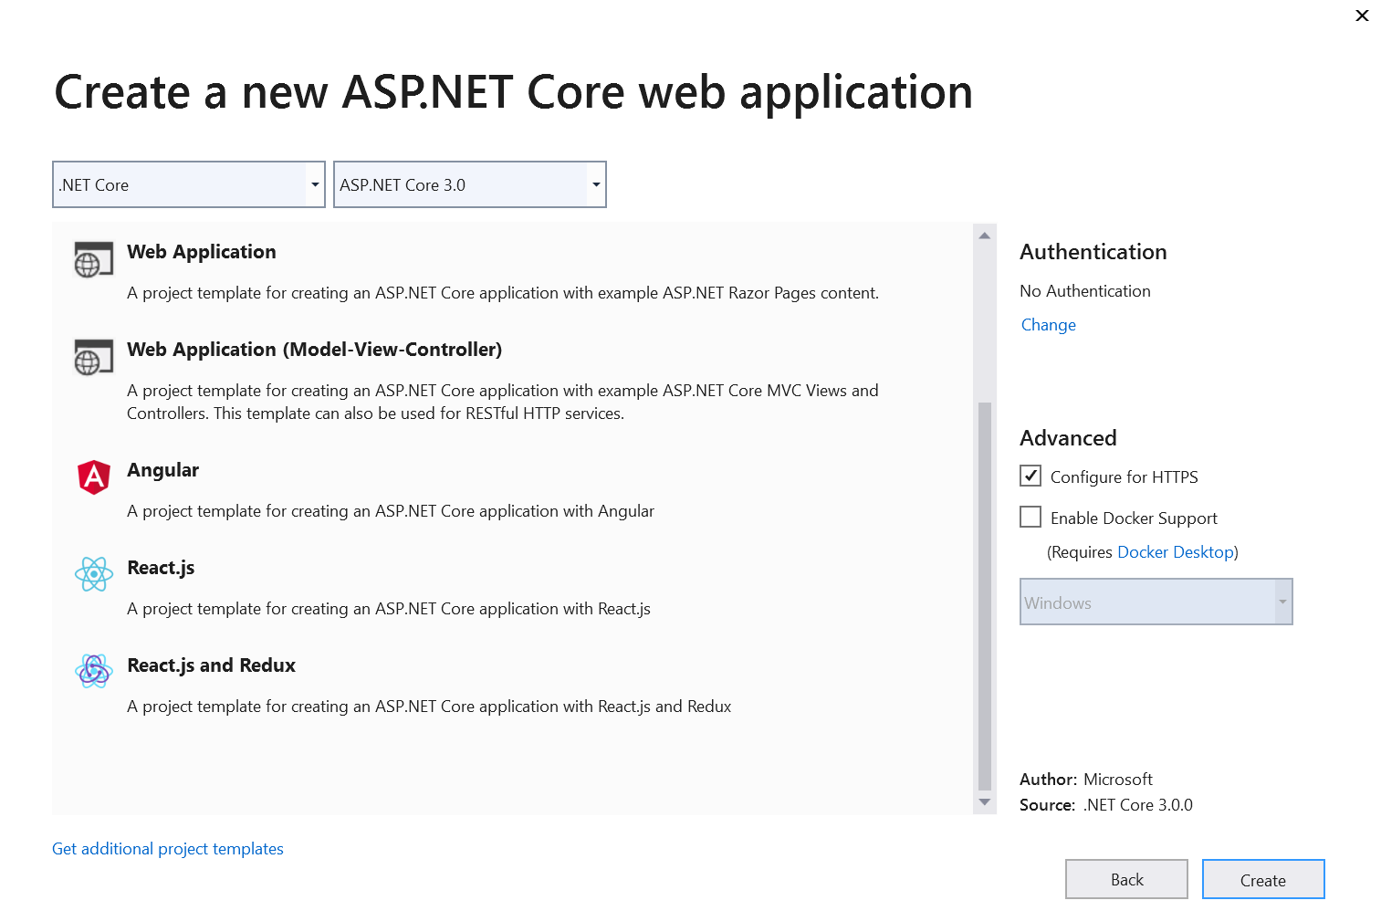

Slide 22

Blazor
Build interactive web UIs using C# instead of JavaScript.
Blazor apps are composed of reusable web UI components implemented using C#, HTML, and CSS.
Client and server code is written in C#, allowing you to share code and libraries.
Notes:
ASP.NET Core 3.0 introduces a new model for building rich, interactive, and composable UI called Blazor. Blazor server-side allows developers to build UI with Razor on the server and for this code to be delivered to the browser and executed client-side using WebAssembly.

Slide 23
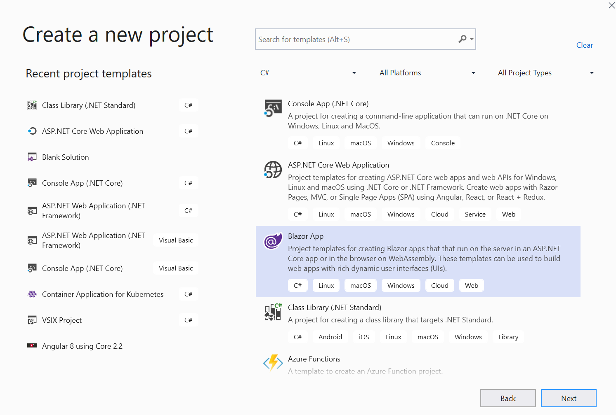
Notes:
To do that you find it in the list Blazor App.

Slide 24
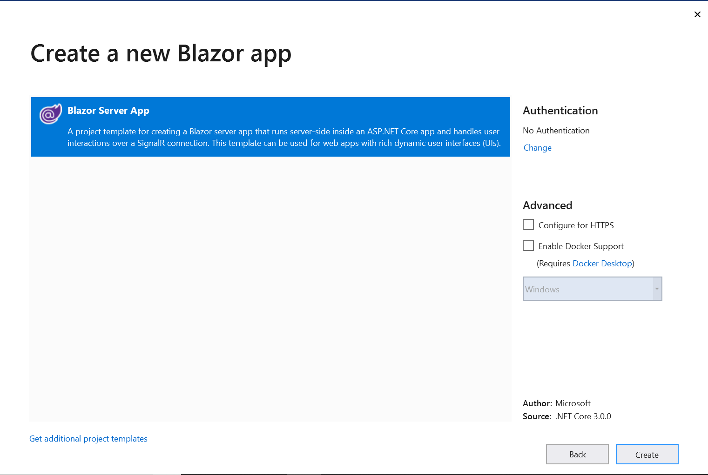
Notes:
To do that you find it in the list Blazor App.

Slide 25
Agenda
Client side web technologies
Server side web technologies
SGBDR and NoSQL
Languages
OS and Cloud Provider

Slide 26
Technologies and Patterns
Notes:
Now we will talk about the server-side technologies, we will be in the heart of any apps, security, performance should be considered in the part, so, it’s really important to have an idea about technologies that any developer should know and can use it and the patterns to build a consistent architecture.

Slide 27



Evolution of Software architecture
1990's
Spaghetti-Oriented architecture
Copy & paste
Traditional "N-Layer" architecture applications
2000's
Lasagne-Oriented architecture
Layered monolith
Monolithic containerized applications
2010's
Ravioli-Oriented architecture
Microservices
Cloud architecture
Notes:
So, let’s start by the evolution of software architecture, it looks like Software development and architecture have always been linked to Italian food. So, here is my take on the evolution of software architecture with an Italian food perspective!
from spaghetti code that was an old way where the developer can’t be able to refactor because the code is highly coupled to lasagne that illustrate the layered monolith or monolith containerized apps finishing to Ravioli architecture and here, we start by cloud ready architecture like microservices, serverless. We don’t know what it is next maybe pizza.

Slide 28
Architectural principles
SOLID Software Design Principles
Microservices Design Principles
Independent Deployment
Modularity
Communication
Size
Single Responsibility
Open/Closed
Liskov Substitution
Interface Segregation
Dependency Inversion
Notes:
You should architect and design software solutions with maintainability in mind. The principles outlined in this section can help guide you toward architectural decisions that will result in clean, maintainable applications. Generally, these principles will guide you toward building applications out of discrete components that are not tightly coupled to other parts of your application, but rather communicate through explicit interfaces or messaging systems.

Slide 29












Monolithic application approach
Microservices application approach
Presentation Layer
Desktop & Mobile
apps
Web apps
Services tier
API Gateway
Business logic Layer
Microservices
SQL DB
or
No-SQL
SQL
[…]
No-SQL
[…]
Stateful service
Database access Layer
Monolithic Databases are shared across services.
Each microservice owns its model/data!
Notes:
Before talking about Microservices, we need to understand the difference between traditional application approach and microservices application approach.
Any application is built as a collection of services can be developed, tested, versioned, deployed, and scaled. For Monolithic applications, Scales is done by cloning the app on multiple servers or VMs.
But for microservices, scales is done by deploying each independently service with multiple instances across servers – VMs.

Slide 30

Microservices architecture
Model approach for distributed and large or complex critical applications that are based on multiple, independent subsystems in the form of autonomous services.
Application is built as a collection of services car be developed, tested, versioned, deployed, and scaled.
S5
S3
App1
App 2
S1
S4
S4
S6
S1
S2
S3
S4
S5
S6
S2
S5
S1
S3
S2
Notes:
But for microservices, the idea is simple, it consists to split your application into a set of smaller, interconnected services instead of building a single monolithic application. Each microservice is a small application that has its own hexagonal architecture consisting of business logic along with various adapters. Some microservices would expose a REST, RPC or message-based API and most services consume APIs provided by other services. Other microservices might implement a web UI.
Microservices are deployed independently with their own database per service so the underlying.

Slide 31
Patterns | Technologies
Microservices
Docker Containers
Autonomous
Bounded Context
Linux Containers
Docker Image
Nomad & addressable services
Isolated
Docker Host
API Gateway
Windows Containers
Docker Registry
Decoupled
Docker Hub
Events
Async. communication
Hyper-V Containers
Event Bus
Message Brokers
Azure Service Bus
Azure Container Registry
Service Discovery
Health Checks
Orchestrators
Transient Failures Handling
Resiliency
Azure Service Fabric
Stateful Services
Commands
Actors
Retries with Exponential Backoff
Azure Container Service
Domain-Driven Design
Circuit Breakers
RabbitMQ
CQRS simplified
Kubernetes
NServiceBus
Aggregates
Docker Swarm
MassTransit
Domain Entity
Domain Events
Mesos DC/OS
Brighter
Mediator
Polly
Notes:
And in this table, we can find more technologies and Patterns.

Slide 32



Tools
GitHub
Visual Studio
Visual Studio Code
Visual Studio Online
Notes:
Now, we need to have an idea about the tools that any developer can use it, before, we mentioned Visual Studio but we have Visual studio Code, an online version is available in preview and GitHub.

Slide 33
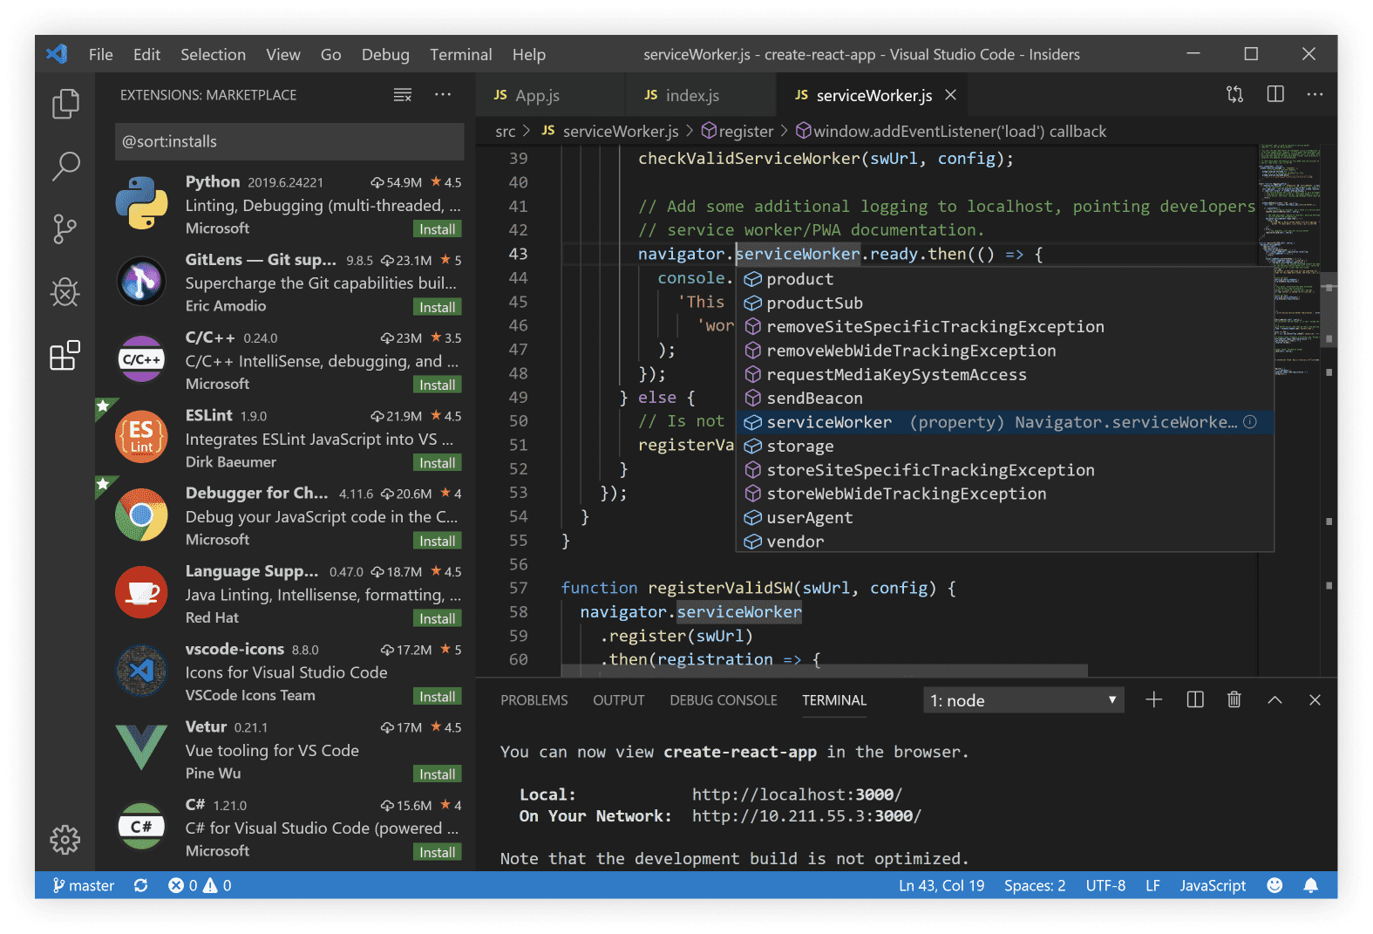
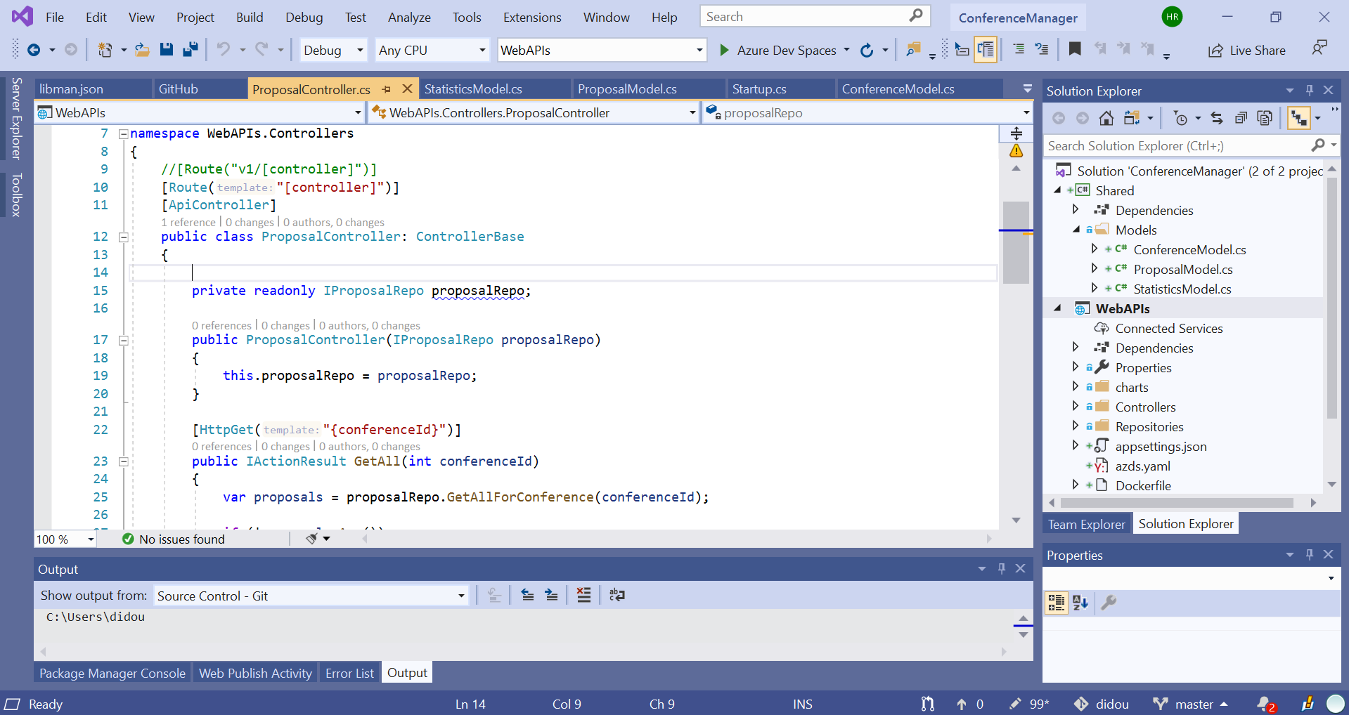
Visual Studio 2019
RELEASED
Edit productively with IntelliCode and additional refactorings
Collaborate with Live Share and GitHub integration
Improve code quality with historical debugging and live unit testing
visualstudio.com/downloads

Slide 34
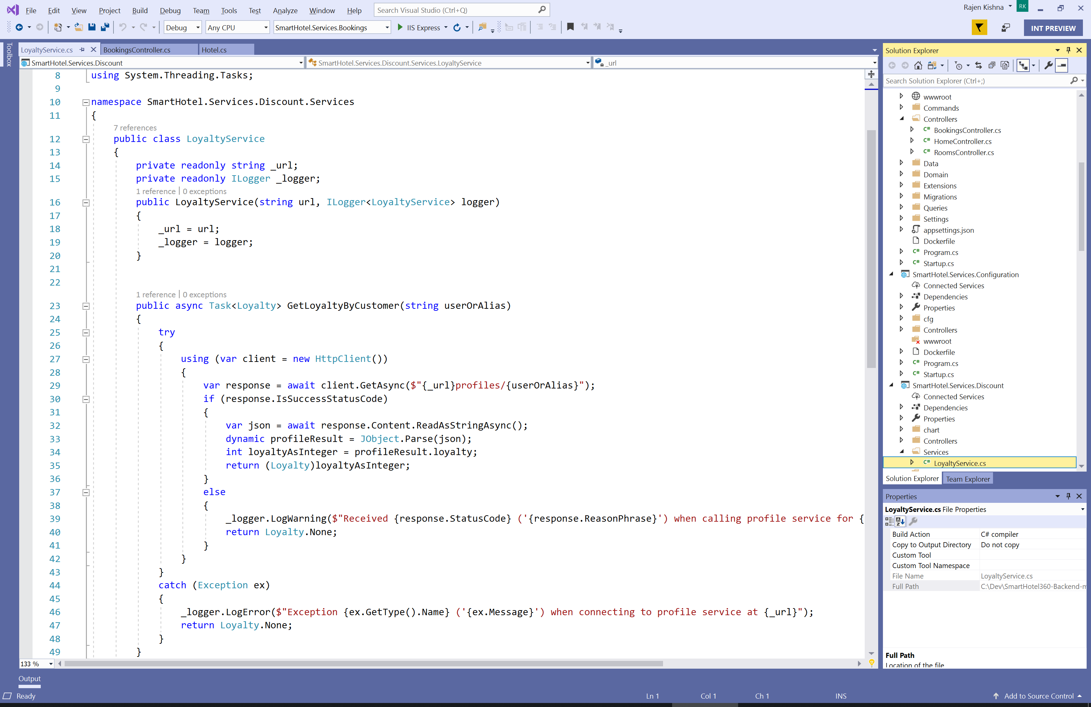
Visual Studio Code
Edit and debug across macOS, Linux, and Windows
Strong ecosystem of over 16k extensions, themes, and tools
Work in containers, WSL, or over SSH with remote development
visualstudio.com/downloads

Slide 35
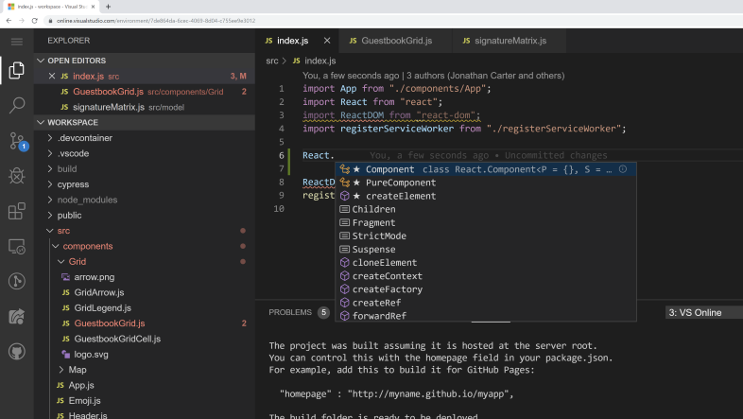
Visual Studio Online
Preview
Accessible cloud development environments from anywhere
Environnements managés pour n’importe quel projet
Expand anywhere
Supports Git repositories, extensions, and an integrated command-line interface
https://visualstudio.microsoft.com/fr/services/visual-studio-online/

Slide 36
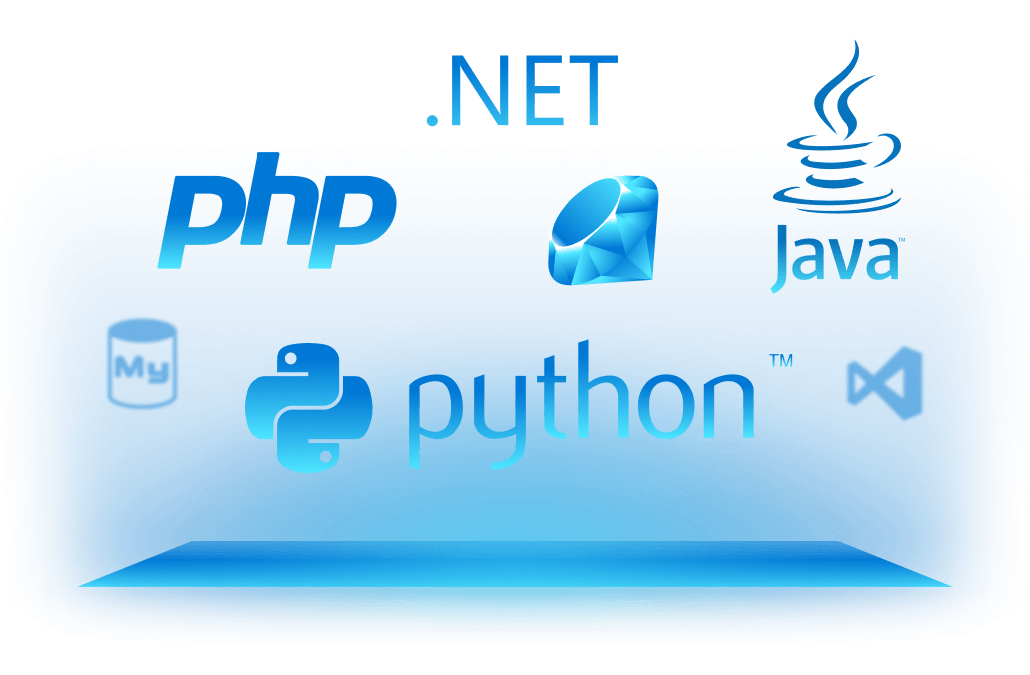
Languages
Notes:
Here we have the languages that you can use it.

Slide 37
Agenda
Client side web technologies
Server side web technologies
SGBDR and NoSQL
Languages
OS and Cloud Provider

Slide 38
Modern Apps on Azure with Containers
Notes:
Now we will move to containers for building modern app

Slide 39
Docker container
Notes:
Containers offer a logical packaging mechanism in which applications can be abstracted from the environment in which they actually run.
This decoupling allows container-based applications to be deployed easily and consistently, regardless of the target environment
Containerization provides a clean separation of concerns – isolation.
Developers focus on their application logic and dependencies; IT Ops focus on deployment and management.

Slide 40
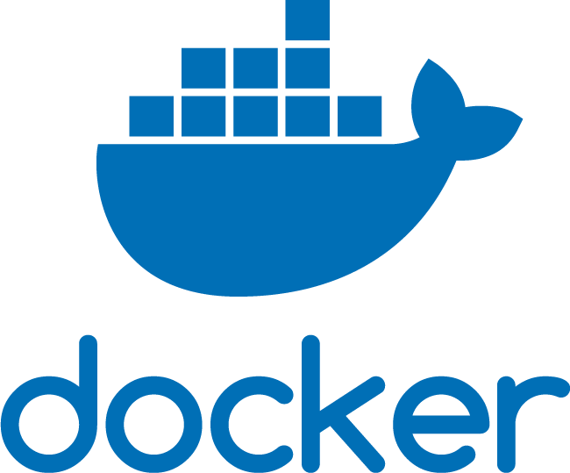
Docker
Technology that allows the creation and use of containers.
Tool that allows developers and sys-admins to easily deploy their applications in a sandbox (containers) to run on the host operating system i.e. Linux.
Notes:
Docker is a technology that allows the creation and use of containers, basically it is a tool that allows developers and sys-admins to easily deploy their applications in a sandbox (containers) to run on the host operating system i.e. Linux.

Slide 41





Containers in Azure
App Service
Service Fabric
Kubernetes Service
Container Instances
Batch
Notes:
Azure provides different choices for app modernization

Slide 42
Azure Container Instances (ACI)
Notes:
To deploy containers in Azure we can use Azure container Instances.

Slide 43
Demo
Create an instance using the Azure CLI

Slide 44
Azure Container Instances (ACI)
Run Containers on Azure without managing servers with a single command
Secure applications with Hypervisor-level isolation
Charged only the time the container is running.
Notes:
You can start a container using a single command. This command can be run on the command line, Azure DevOps, LogicApps; many options.
Per second billing, Only be charged for the time the container is running.
Just run the container, there is no infrastructure to manage.

Slide 45
Demo
Run containers in Azure Container Instances

Slide 46
Azure App Service
Notes:
To publish application we can use Azure App Service
It is a fully managed compute platform that is optimized for hosting websites and web applications.
Customers can use App Service on Linux to host web apps natively on Linux for supported application stacks.
Node, Java, PHP, Python, .NET Core, Ruby can all be run natively or within containers.

Slide 47
Azure App Service
Supports Windows and Linux platforms
Scalability and high availability with auto-patching
Optimization Continuous deployment with Git, Team Foundation Server, GitHub and DevOps
Built-in autoscale and load balancing
Notes:
Azure App Service is an HTTP-based service for hosting web applications, REST APIs, and mobile back ends. You can develop in your favorite language, be it .NET, .NET Core, Java, Ruby, Node.js, PHP, or Python. Applications run and scale with ease on both Windows and Linux-based environments.
Deploy Apps from GitHub, Azure DevOps, even DropBox! App Service offers just about every piece you’d need to run a scalable, secure web application.
Speak to slot deployments, scalability points, and that is the basis for serverless apps too.

Slide 48
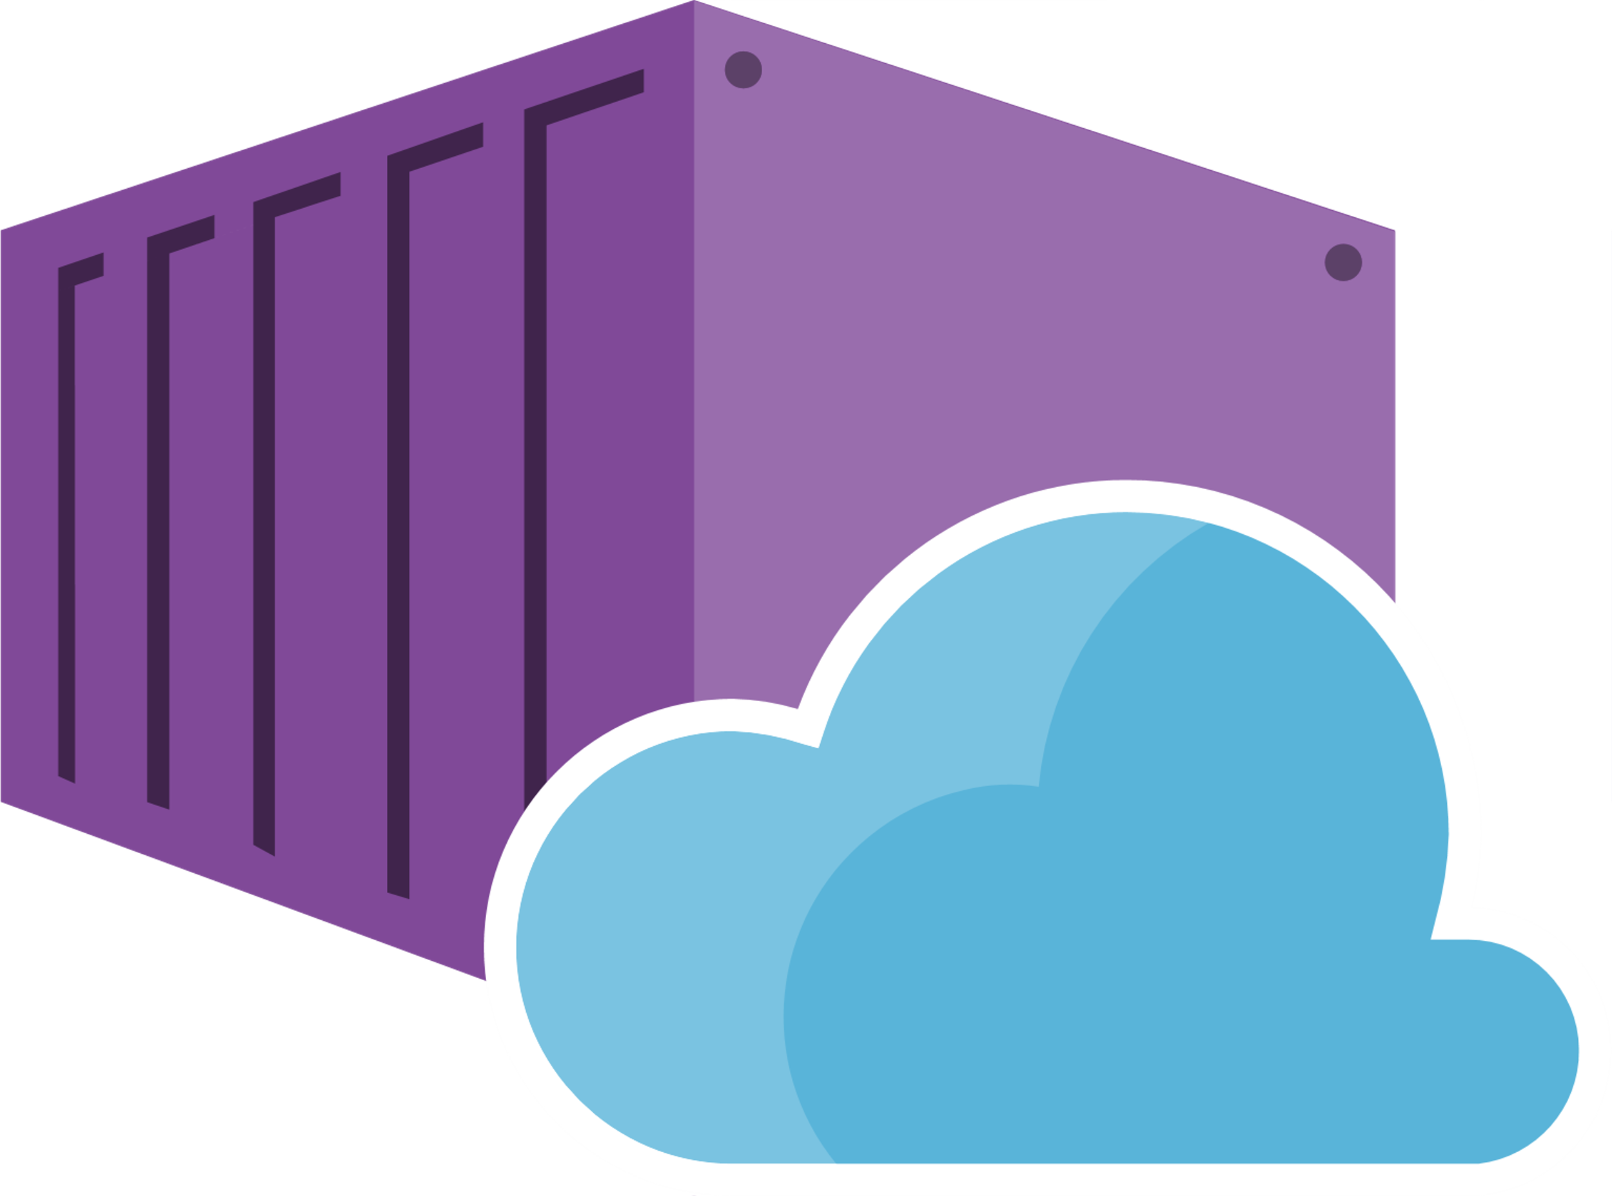
Web App for Containers
Easily deploy and run containerized applications on Windows and Linux.
Build-in auto scale and load balancing
CI/CD with Docker Hub, Azure Container Registry, and GitHub.
Notes:
Just pull container images from Docker Hub or a private Azure Container Registry, and Web App for Containers will deploy the containerized app with your preferred dependencies to production in seconds.
Simplify your container image deployments through CI/CD) capabilities with Docker Hub, Azure Container Registry, and DevOps. App Service creates an association with the selected repository, so your apps are updated each time your source code changes.
Scaling based on load; CPU, memory etc. Load balancing is handled, Can be overridden manually with CLI or in the portal.

Slide 49
Demo
Deploy on Azure Web App for Containers

Slide 50


Hamida REBAI TRABELSI
MVP in Developer Technologies
. Net Consultant
Twitter: @rebaihamida
Email: didourebai@gmail.com
Github:

